Slide 1
TN3125
Information and Computation
Lecture 1
2 – A probability refresher and an information measure

Slide 2

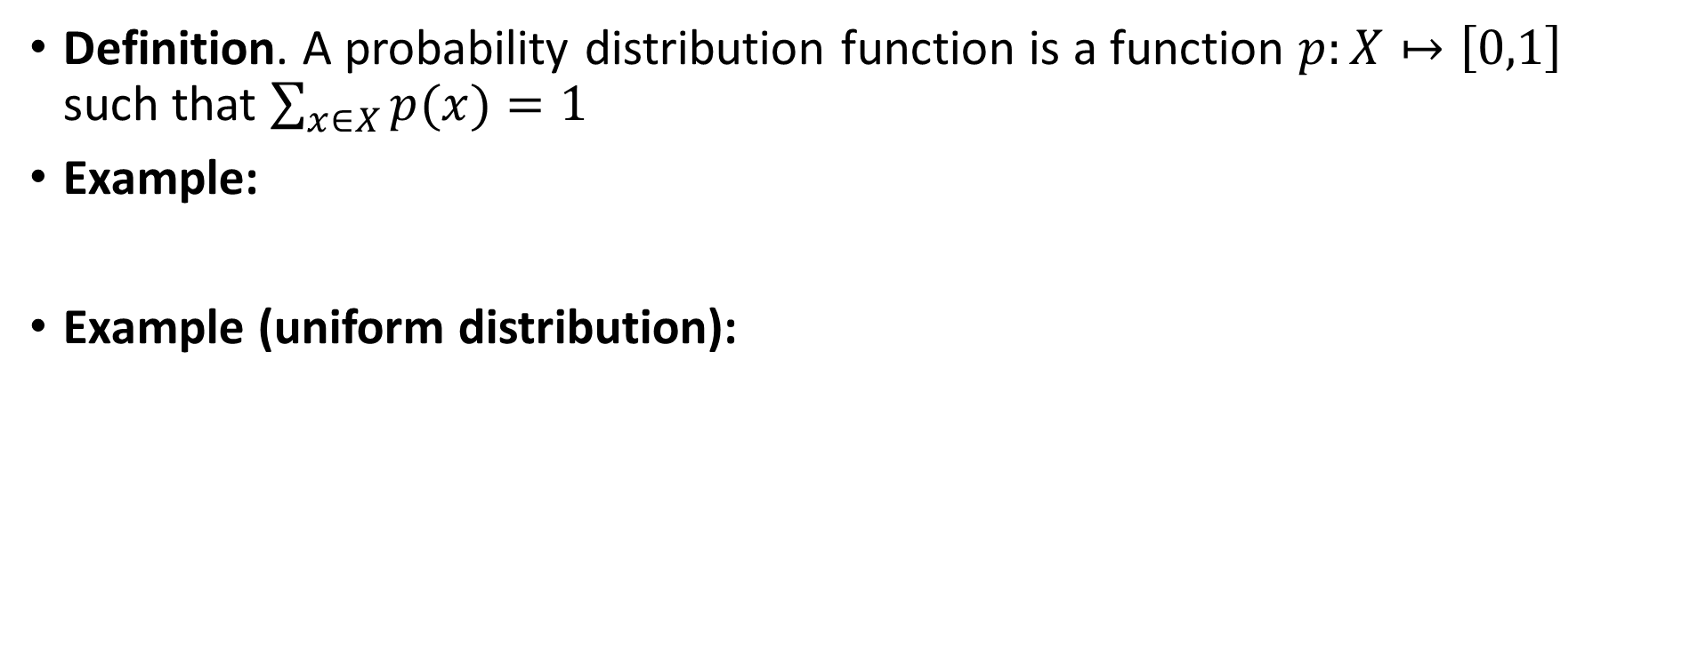

A probability refresher
Definition. A probability distribution function is a function $p:X↦\left[0,1\right]$ such that $\sum_{x∈X}{p(x)}=1$
Example:
Example (uniform distribution):

Slide 3

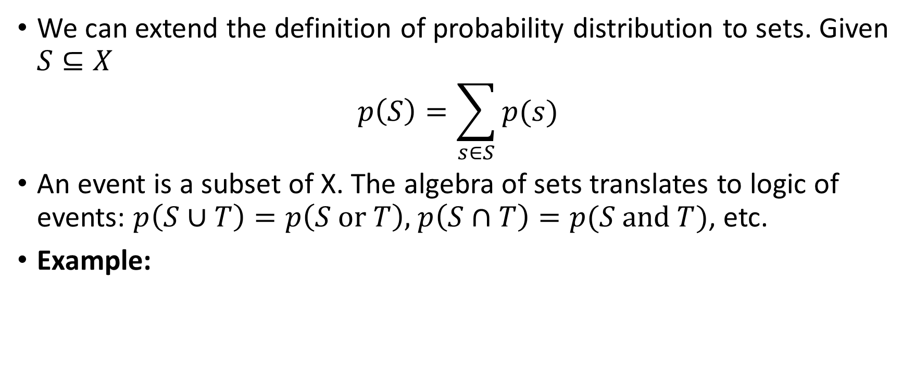

A probability refresher
We can extend the definition of probability distribution to sets. Given $S⊆X$
$$p\left(S\right)=\sum_{s∈S}{p(s)}$$
An event is a subset of X. The algebra of sets translates to logic of events: $p\left(S∪T\right)=p\left(S \text{or} T\right),$ $p\left(S∩T\right)=p(S \text{and} T)$, etc.
Example:

Slide 4
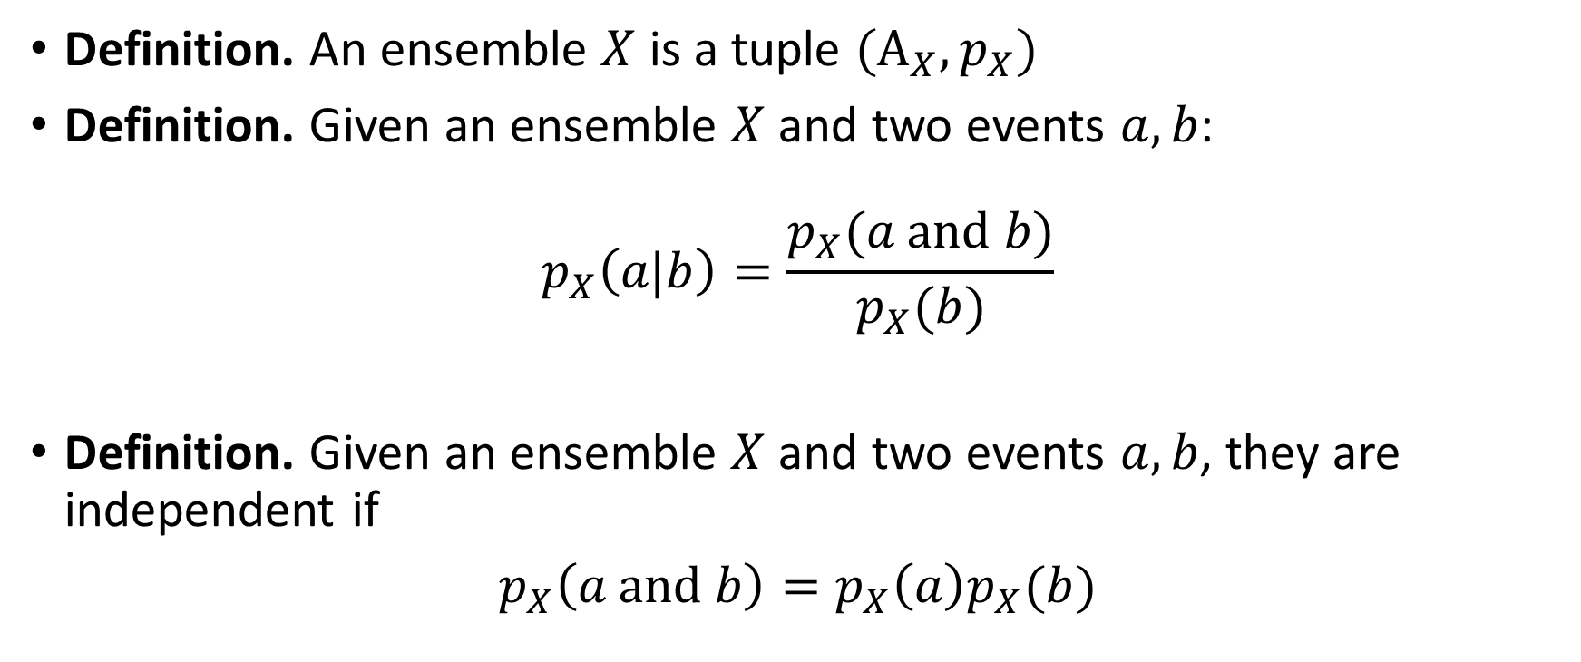
A probability refresher
Definition. An ensemble $X$ is a tuple $(A_{X},p_{X})$
Definition. Given an ensemble $X$ and two events $a,b$:
$$p_{X}\left(a\text{|}b\right)=\frac{p_{X}(a \text{and} b)}{p_{X}(b)}$$
Definition. Given an ensemble $X$ and two events $a,b$, they are independent if
$p_{X}\left(a \text{and} b\right)=p_{X}\left(a\right)p_{X}(b)$

Slide 5

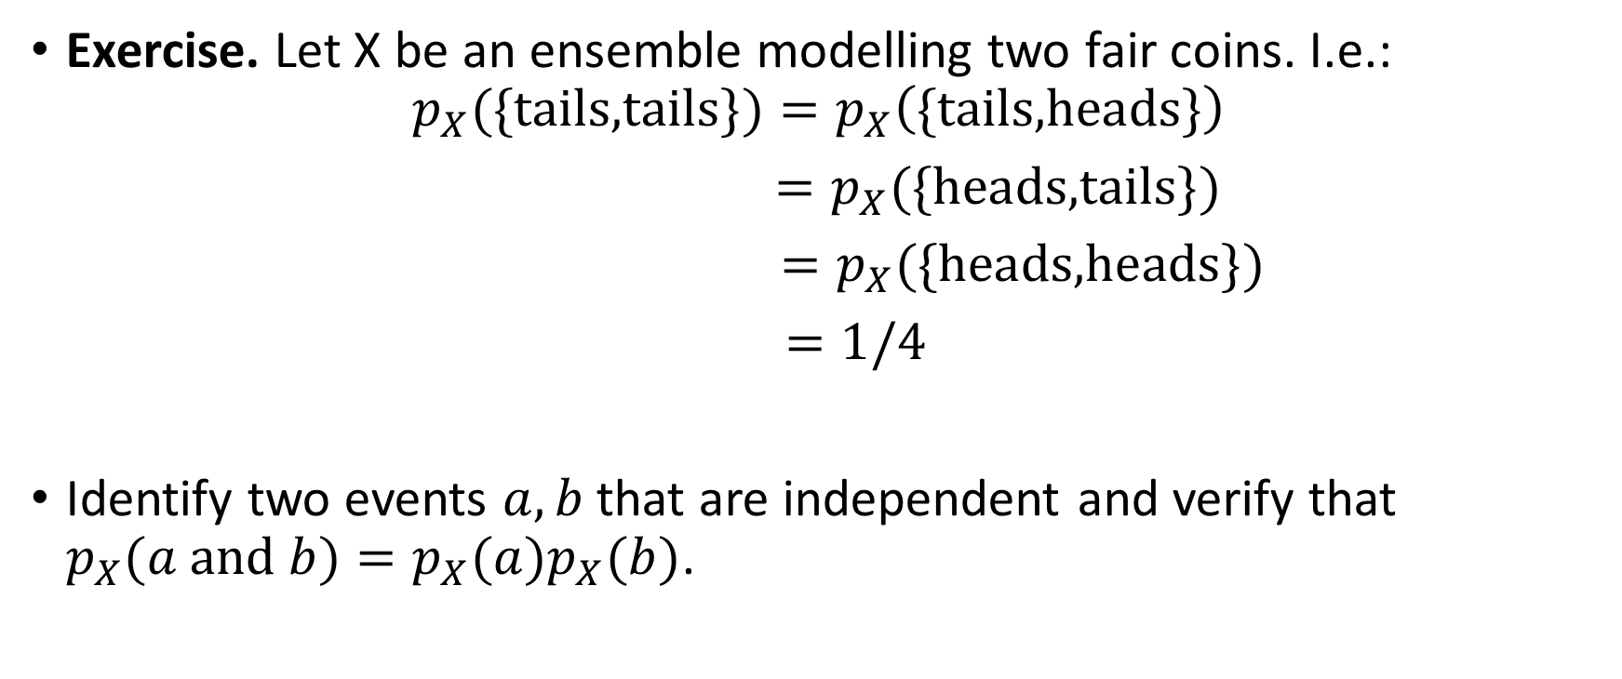
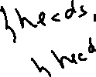



A probability refresher
Exercise. Let X be an ensemble modelling two fair coins. I.e.:
$$p_{X}(\text{\{}\text{tails}\text{,}\text{tails}\text{\}})=p_{X}\left(\text{\{}\text{tails}\text{,}\text{head}\text{s}\text{\}}\right)$$
$=p_{X}(\text{\{}\text{head}\text{s}\text{,}\text{tails}\text{\}})$
$=p_{X}(\text{\{}\text{head}\text{s}\text{,}\text{head}\text{s}\text{\}})$
$=1/4$
Identify two events $a,b$ that are independent and verify that $p_{X}(a \text{and} b)=p_{X}(a)p_{X}(b)$.

Slide 6
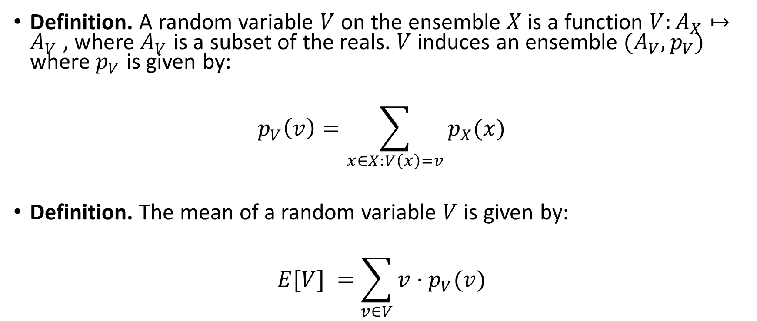
A probability refresher
Definition. A random variable $V$ on the ensemble $X$ is a function $V:A_{X}↦A_{V}$ , where $A_{V}$ is a subset of the reals. $V$ induces an ensemble $(A_{V},p_{V})$ where $p_{V}$ is given by:
$$p_{V}\left(v\right)=\sum_{x∈X:V\left(x\right)=v}{p_{X}(x)}$$
Definition. The mean of a random variable $V$ is given by:
$$E[V] =\sum_{v∈V}{v⋅p_{V}(v)}$$

Slide 7

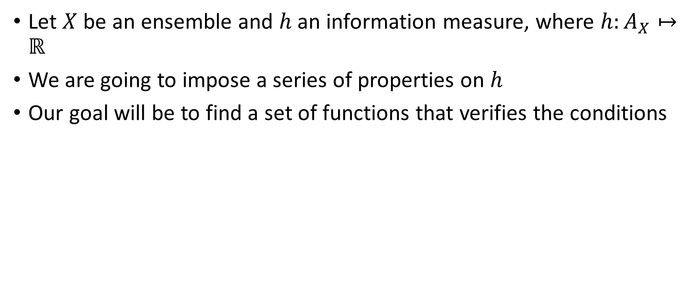
Axiomatic derivation of an information measure
Let $X$ be an ensemble and $h$ an information measure, where $h:A_{X}↦ℝ$
We are going to impose a series of properties on $h$
Our goal will be to find a set of functions that verifies the conditions
Vectors by www.Vecteezy.com
Notes:
Make the intuition from lecture one concrete

Slide 8
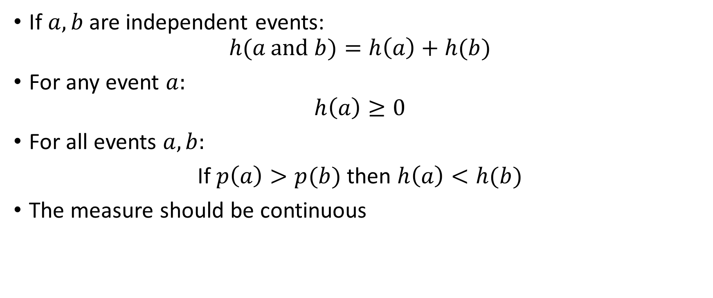
Axiomatic derivation of an information measure
If $a,b$ are independent events:
$$h(a \text{and} b)=h\left(a\right)+h(b)$$
For any event $a:$
$$h\left(a\right)≥0$$
For all events $a,b:$
If $p\left(a\right)>p(b)$ then $h\left(a\right)<h(b)$
The measure should be continuous

Slide 9


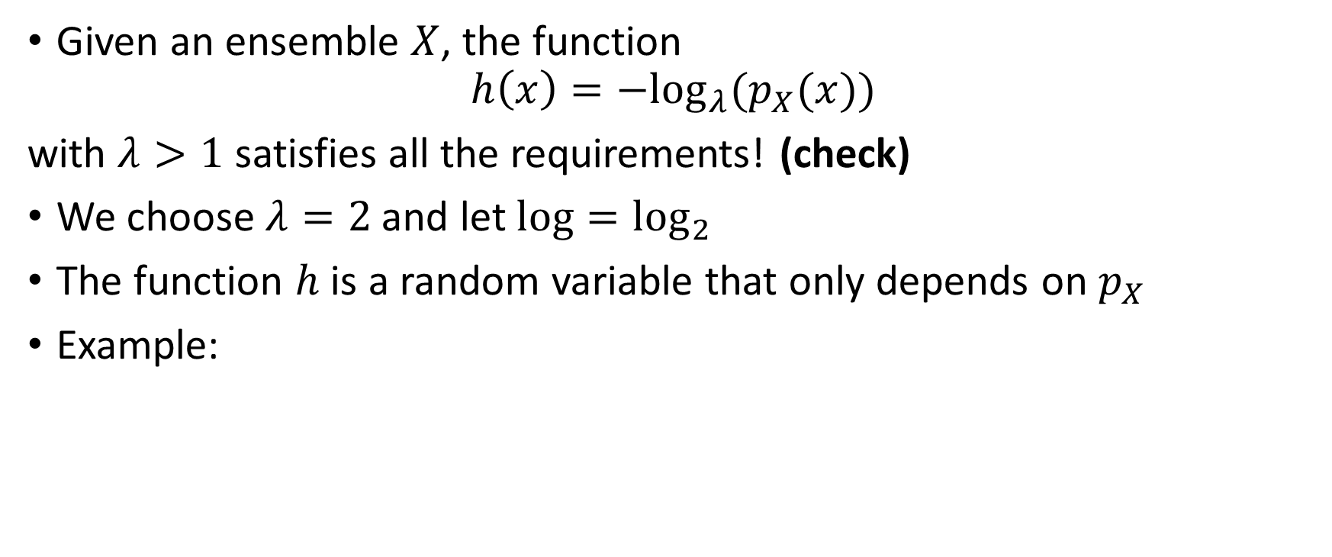
The entropy function
Given an ensemble $X$, the function
$$h\left(x\right)=−\log_{λ}⁡(p_{X}(x))$$
with $λ>1$ satisfies all the requirements! (check)
We choose $λ=2$ and let $log⁡=\log_{2}⁡$
The function $h$ is a random variable that only depends on $p_{X}$
Example:

Slide 10










Slide 11
 | Days with no rain | Days with rain
Rotterdam | 212 | 153
Atacama desert | 360 | 5
Exercise 1.1 - Let us assume that you are living in the Atacama desert where it rarely rains. How much information do the messages 0 and 1 carry?

Slide 12
 | Days with no rain | Days with rain
Rotterdam | 212 | 153
Atacama desert | 360 | 5
Exercise 1.1 - Let us assume that you are living in the Atacama desert where it rarely rains. You receive a 0. How much information does this message carry?
Exercise 1.2 - Now let us assume that you live in the Netherlands where it does rain quite often, but certainly not every day. How much information do the messages 0 and 1 carry?

Slide 13
 | Days with no rain | Days with rain
Rotterdam | 212 | 153
Atacama desert | 360 | 5
Exercise 1.1 - Let us assume that you are living in the Atacama desert where it rarely rains. You receive a 0. How much information does this message carry?
Exercise 1.2 - Now let us assume that you live in the Netherlands where it does rain quite often, but certainly not every day. You receive a 0. Does the message contain information?
Exercise 1.3 - Finally, let us assume that you live in the Netherlands but (boldly) also that you are aware of the current season. You receive a 0. Does the message 0 carry the same information in summer and in winter?

Slide 14
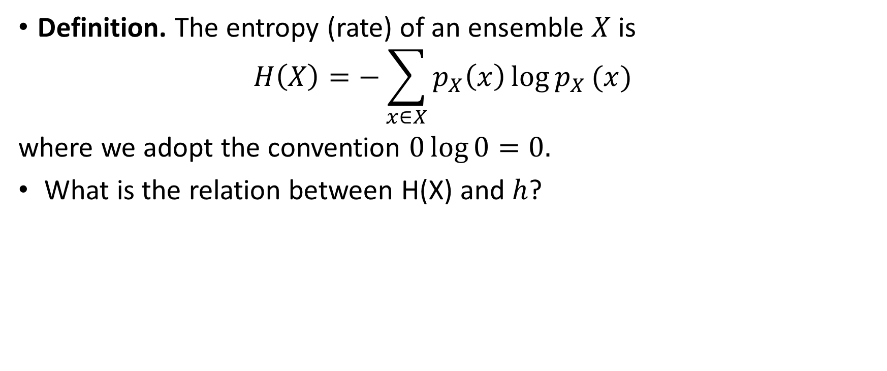
Entropy rate
Definition. The entropy (rate) of an ensemble $X$ is
$$H\left(X\right)=−\sum_{x∈X}{p_{X}\left(x\right)\log{p_{X}}(x)}⁡$$
where we adopt the convention $0\log{0}=0.$
What is the relation between H(X) and $h$?

Slide 15
Exercises
What is the entropy of a fair coin?
What is the entropy of a coin that always yields tails?
Can entropy be smaller than 0?

Slide 16
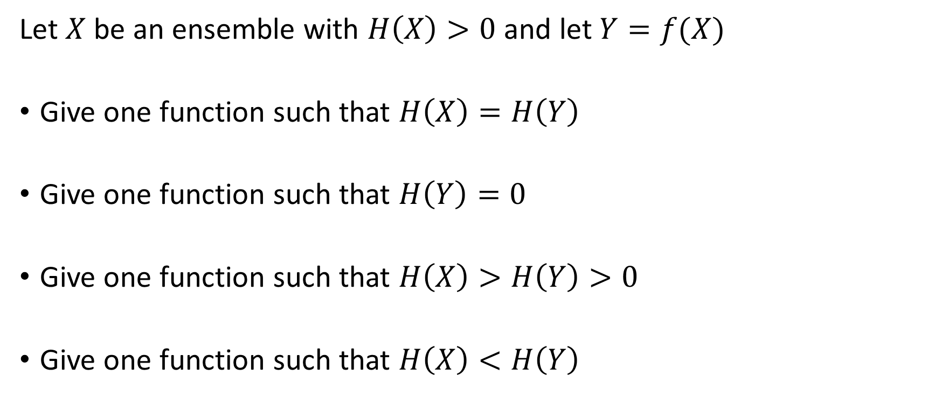


Exercises
Let $X$ be an ensemble with $H\left(X\right)>0$ and let $Y=f(X)$
Give one function such that $H\left(X\right)=H\left(Y\right)$
Give one function such that $H\left(Y\right)=0$
Give one function such that $H\left(X\right)>H\left(Y\right)>0$
Give one function such that $H\left(X\right)<H\left(Y\right)$
Notes:
x1

Slide 17





















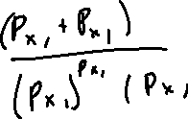

Slide 18











